Slide 1
IDA – Search
prof. Anna Wilbik

Slide 2
Course overview
Introduction to DS & AI
What is AI?
Exploratory Data Analysis
Agents
Data Mining
Search
Mathematical Modeling
Logic
Mathematical Simulations
Learning
Game Theory
Information Retrieval
Computer Class
Ethics in AI

Slide 3
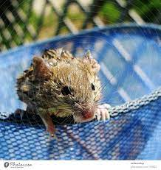
Homework
The video had a mouse trying to escape out of a pool of water
You were asked; “If you were designing a successful mouse agent, what sensors and action functions would it need?”

Slide 4
Homework answers
If you were designing a successful mouse agent, what sensors and action functions would it need?
Sensors
Cat angle
Distance from edge (distance to middle implicit)
Actions
Dash for edge
Circling
Move towards sweet spot

Slide 5
Course overview
Introduction to DS & AI
What is AI?
Exploratory Data Analysis
Agents
Data Mining
Search
Mathematical Modeling
Logic
Mathematical Simulations
Learning
Game Theory
Information Retrieval
Computer Class
Ethics in AI

Slide 6
Search
Many AI approaches rely on search to find the ‘best’ solution to a problem.
By searching through the possible solutions we can find the solution we need.

Slide 7
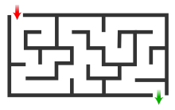
Mazes

Slide 8
Mazes
A
B
C
D
E
F
G
H
I
J
K
L
M
N

Slide 9
Making a tree
A
B
H
A
Dead end
E
I
B
C
D
Dead end
F
L
E
F
G
H
C
J
I
J
K
L
M
N
D
K
G
N
M
✓

Slide 10
Tree Terminology
Root: node without parent (A)
Descendant of a node: child, grandchild, grand-grandchild, etc.
Internal node: node with at least one child (A, B, C, F)
Leaf node (a.k.a. leaf ): node without children (E, I, J, K, G, H, D)
Ancestors of a node: parent, grandparent, grand-grandparent, etc.
Subtree: tree consisting of a node and its descendants
A
subtree
B
C
D
E
F
G
H
I
J
K

Slide 11
Tree terminology practice
A
Which nodes are the ancestors of L?
A, H, I
Which nodes are internal nodes?
A, H, I, F, C, K, N
Is N a leaf?
No
Is A the root?
Yes
How many grandchildren does I have?
2 (C and J)
B
H
Dead end
E
I
Dead end
F
L
C
J
D
K
G
N
M
✓

Slide 12
Searching a tree
Now we have a strategy to build a search tree from any simple maze.
We need an algorithm to search this tree for the solution.
We will look at two of the simplest algorithms:
Breadth first search
Depth first search

Slide 13
Breadth first search
Look at the root, if it isn’t a solution…
Look at all children of the root, if no solution…
Look at all grandchildren of the root, if no solution…
Etc.
Search order
A
B
H
Dead end
E
I
Dead end
F
L
C
J
D
K
G
N
A, B, H, E, I, F, L, C, J, D, K, G, N, M, Exit
M
✓

Slide 14
Depth first search
A
In depth first search we go as deep as we can with each path, until we reach a leaf, then we backtrack up the tree
Search order
B
H
Dead end
E
I
Dead end
F
L
C
J
D
K
A, B, H, E, I, F, C, D, K, G, N, M, exit
(Never visit J and L)
G
N
M
✓

Slide 15
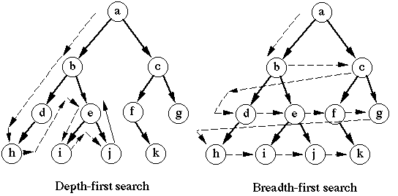
Breadth first vs Depth first
Notes:
Depth first search makes sense if you (or a robot) are exploring a maze, less travelling between points you want to search
If there are multiple routes to the exit, then breadth first will find the shortest first (least junctions passed)
Node ordering will be important with both methods – if you have extra information which might suggest which child is more likely to lead to a solution – put that child first.

Slide 16
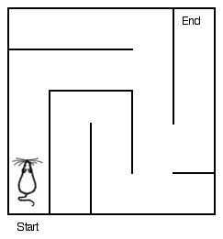
Maze search, practice
Draw the tree associated with this maze
Which search method will visit the least number of nodes in its search for the exit?
A
B
C
D
E
F

Slide 17
Maze search, practice
Draw the tree associated with this maze
Which search method will visit the least number of nodes in its search for the exit?
A
B
B
A
C
C
E
✓
D
E
F
D
F

Slide 18
Maze search, practice
Draw the tree associated with this maze
Which search method will visit the least number of nodes in its search for the exit?
Breadth first – B, A, C, E, exit
Depth first – B, A, C, E, D, F, exit
A
B
B
A
C
C
E
✓
D
E
F
D
F

Slide 19
Another application: Planning a route
Den Haag
0.5
Utrecht
We want to build a search tree to plan a route from Maastricht to Den Haag, taking into account journey times to find the quickest route.
0.4
0.5
1
Rotterdam
Eindhoven
1
1
Maastricht

Slide 20
Planning a route – breadth first
Den Haag
0.5
Utrecht
Maastricht: 0
0.4
0.5
1
Eindhoven:1
Rotterdam
Eindhoven
1
Utrecht:2
Rotterdam:2
1
Maastricht
Rotterdam: 2.5
Den Haag: 2.5
Utrecht: 2.5
Den Haag: 2.4
We can stop now, as we have found a way to get to Den Haag in 2.4 hours, and the rest of the search paths in our tree have already clocked up 2.5 hours.

Slide 21
Planning a route – depth first
0.5
Maastricht: 0
Den Haag
Utrecht
0.4
0.5
1
Eindhoven:1
Rotterdam
Eindhoven
1
Utrecht:2
Rotterdam:2
1
Maastricht
Rotterdam: 2.5
Den Haag: 2.5
Utrecht: 2.5
Den Haag: 2.4
Eindhoven: 3.5
Den Haag: 2.9
Eindhoven: 3.5
Den Haag: 2.9
Prune cycle, as we’ve already seen Eindhoven in this search path

Slide 22
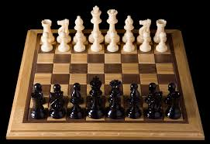
Search in games

Slide 23
Game Tree
Search depth d
Number of state transitions (moves) from the root of the search to the considered state position (measured in ply)
Branching factor b
Average number of successor nodes (moves)
Notes:
ply is one turn taken by one of the players

Slide 24
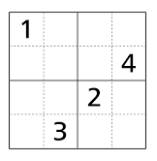
Example: Sudoku 4x4
12 cells to fill
Consider that we fill cells one-by-one (fixed order)
Each node has 4 children (1,2,3,4)
some children will be discarded
Max tree depth:
12
Branching factor:
4

Slide 25
Adversary Search
Two (or more) opponents, each trying to maximize their expectations
Player 1 is called MAX
Obtain the maximum result
Minimize that of the opponent
Player 2 is called MIN
Obtain the minimum result
Maximize that of the opponent

Slide 26
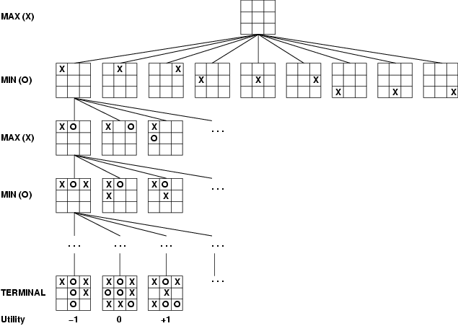
Game tree (2-player, deterministic, turn-taking)
root node
internal node
leaf node

Slide 27
MiniMax Search (Von Neumann, 1928)
Max
3
3
2
Min
Max
3
4
2
7

Slide 28
Principal Variation
Notes:
Path from root to leaf node of optimal (=rational) play by each side
This is an optimal action sequence
Also known as the main line, or optimal path

Slide 29
Exercise: MiniMax Search
3
5
6
9
1
2
0
-1

Slide 30
Exercise: Minimax Search
Nim-5
Players remove on turn 1, 2, or 3 matches. The player who takes the last match wins the game.
Draw the game tree, including the minimax values

Slide 31
Game Tree: First Steps
Number of matches
5
1
2
3
4
1
2
3
3
1
2
3
2
1
0
1
2
1
1
0
0
1
0
Utility
+1
–1
–1
+1

Slide 32
Minimax Search
5
1
2
3
4
3
2
1
2
3
1
2
3
1
2
+1
3
2
1
2
1
0
1
0
1
2
3
1
2
1
1
2
1
1
–1
2
1
0
1
0
0
1
0
0
0
1
2
1
1
1
1
0
0
0
0
1
0
Utility/payoff
+1
–1
–1
+1
–1
+1
+1
–1
+1
+1
–1
+1
–1

Slide 33
Minimax Search
+1
MINIMAXING
1
2
3
+1
–1
–1
1
2
3
1
2
3
1
2
+1
+1
+1
+1
+1
–1
+1
–1
1
2
3
1
2
1
1
2
1
1
–1
–1
+1
–1
+1
+1
–1
+1
+1
+1
1
2
1
1
1
+1
–1
–1
–1
–1
1
+1
+1
–1
–1
+1
–1
+1
+1
–1
+1
+1
–1
+1
–1

Slide 34
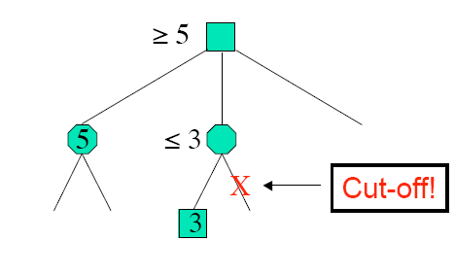
Observation
Notes:
Some nodes in the search can be proven to be irrelevant to the outcome of the search
Assume we traverse the tree from left to right in a depth-first way

Slide 35
Minimax Search - pruning
MAX
Will a different value of the node with red circle influence the value of the node with blue circle ?
MIN
≤ 5
MAX
5
≥ 6
3
5
6
9
1
2
0
-1

Slide 36
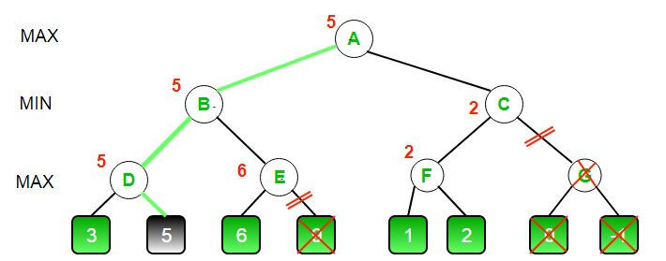
Minimax Search - pruning

Slide 37
Homework: which nodes can be pruned?
5
6
7
4
5
3
6
6
9
7
5
9
8
6

Slide 38
Computer Game-Playing
Sizes of game trees:
Nim-5: 28 nodes
Tic-Tac-Toe: ≈ 10⁵ nodes
Checkers: ≈ 10³¹ nodes
Chess: ≈ 10¹²³ nodes
Go: ≈ 10³⁶⁰ nodes
Notes:
In practice it is intractable to find a solution with minimax: so use heuristic search

Slide 39
Heuristic Search
Truncate the game tree (limited search depth)
Use a (static heuristic) evaluation function at the leaves
Minimax (with pruning) on the reduced game tree
Playing is solving a sequence of these game trees
0.25
1
2
3
0.25
–1
–1
1
2
3
1
2
3
1
2
0.25
0.33
0.5
0.33
0.5
–1
0.5
–1

Slide 40
Heuristic Evaluation Function
Heuristics values must be correlated with the true (game-theoretic) value
For chess, typically linear weighted sum of features
Eval(s) = w₁*f₁(s) + w₂*f₂(s) + … + w_{n}*f_{n}(s)
e.g., w₁ = 9 with
f₁(s) = (number of white queens) – (number of black queens), etc.

Slide 41
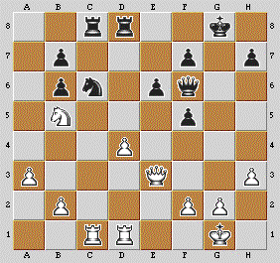
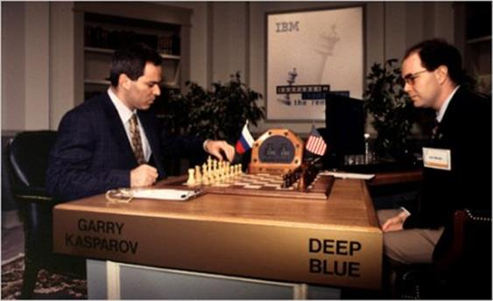
Chess
Much research has been performed in Computer Chess
Deep Blue (IBM) defeated the world champion Kasparov in 1997
A Micro Computer better than the world champion?
December 2006: Deep Fritz 10 vs. Kramnik 4-2

Slide 42
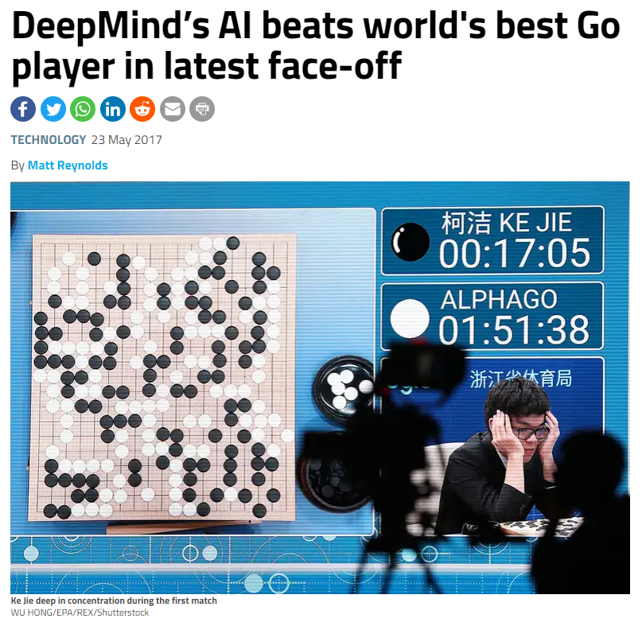
(https://www.newscientist.com/article/2132086-deepminds-ai-beats-worlds-best-go-player-in-latest-face-off/)

Slide 43
Other Questions?
How to search in imperfect information (=partially observable) games?
Games with chance (stochastic)
More than two players?
Moving at the same time (simultaneous move games)?

Slide 44
Intelligent Search Techniques
Reasoning Techniques
Intelligent Search & Games
More on route finding in
Graph theory
Planning and Scheduling

Slide 45
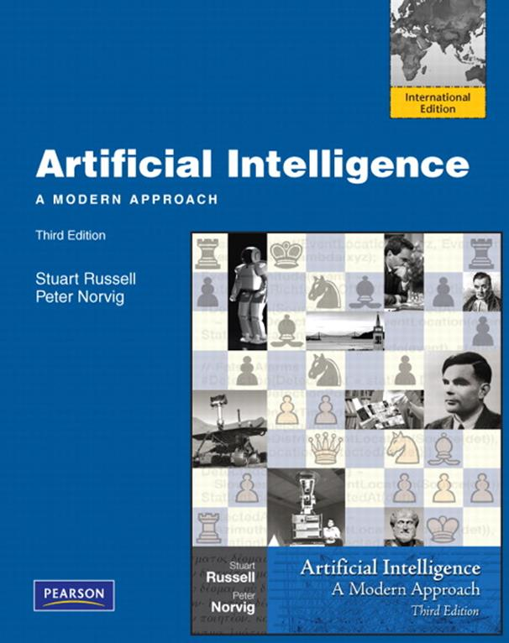
Required reading
Chapter 3 – stop at start of 3.4.4
Chapter 5, 5.1 and 5.2

Slide 46
Exam checklist:
Tree terminology
Using trees for search
Breadth first search
Depth first search
Minimax search
Pruning

